Slide 1

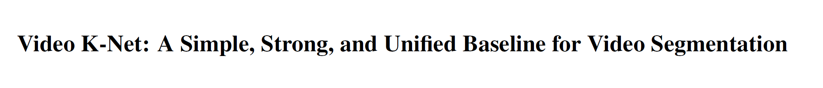





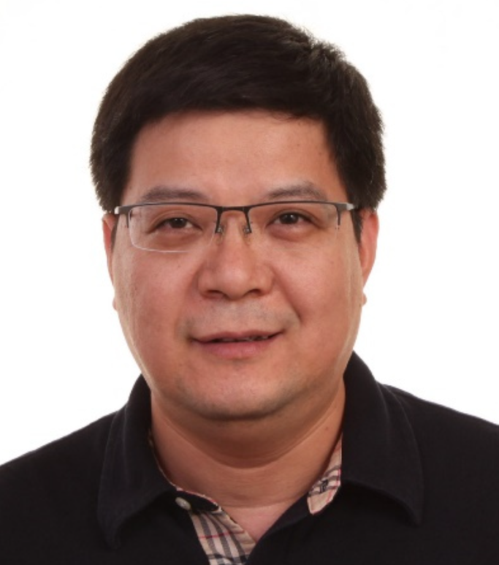
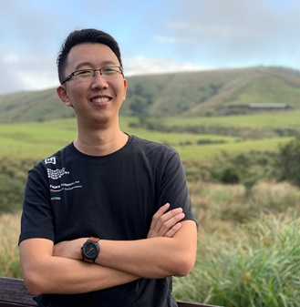



Xiangtai Li*
Wenwei Zhang*
Jiangmiao Pang*
Kai Chen
Guangliang Cheng
Yunhai Tong
Chen Change Loy

Slide 2
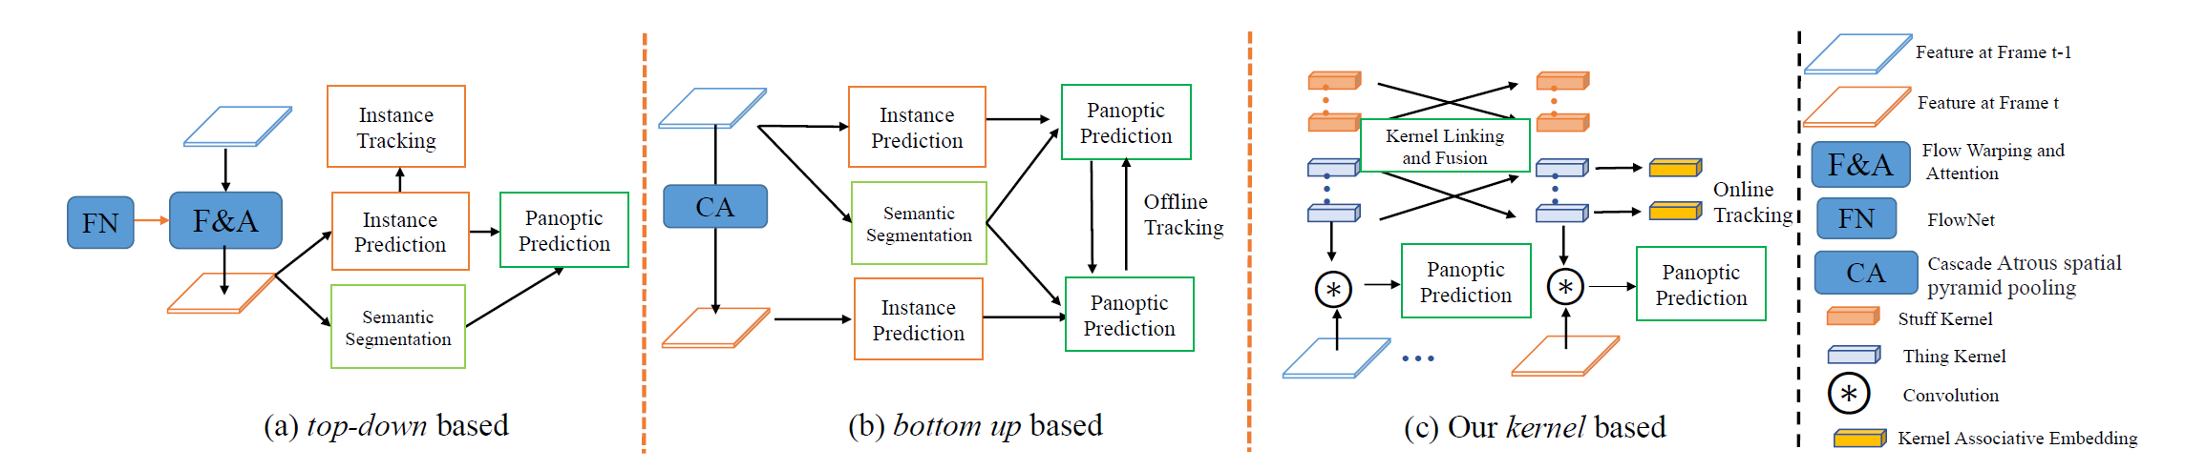
Motivation
Fig.1 Current Solution For Video Panoptic Segmentation (VPS)
Unified Video Segmentation or Video Panoptic Segmentation(VPS):
Complex and hand-crafted Pipeline for VPS.
Need the post process or offline tracking.
Need Optical flow learning and warping.
Tackle the segmentation and tracking with specific task head.
Is there any simpler solution for VPS?
Notes:
感谢各位老师

Slide 3
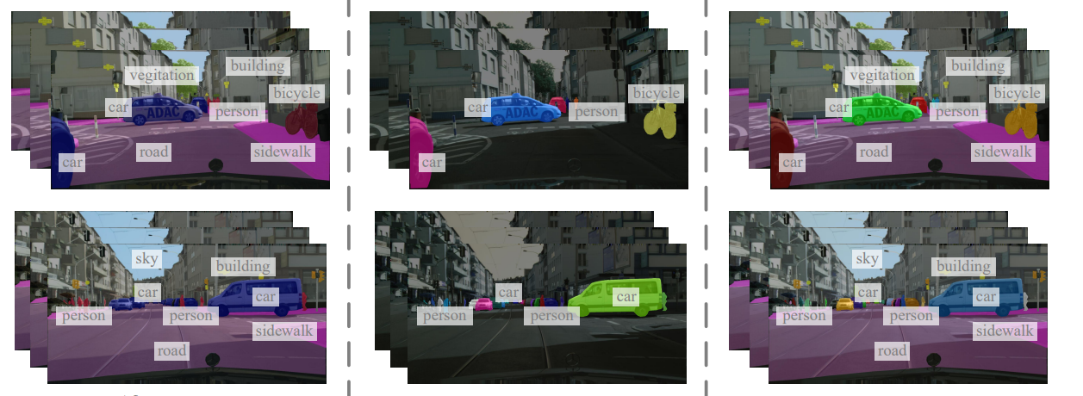
Motivation
VSS
VIS
VPS
Fig.2 Current Video Segmentation Tasks.
Other Video Segmentation Tasks:
Different Tasks have different solutions including specific design. Such as Optical Flow Warping or Clip-Level Transformer.
Video Semantic Segmentation (VSS): no instance tracking.
Video Instance Segmentation (VIS): no background context.
Is there any unified architecture to solve all video segmentation tasks including VPS, VIS and VSS?
Notes:
感谢各位老师

Slide 4
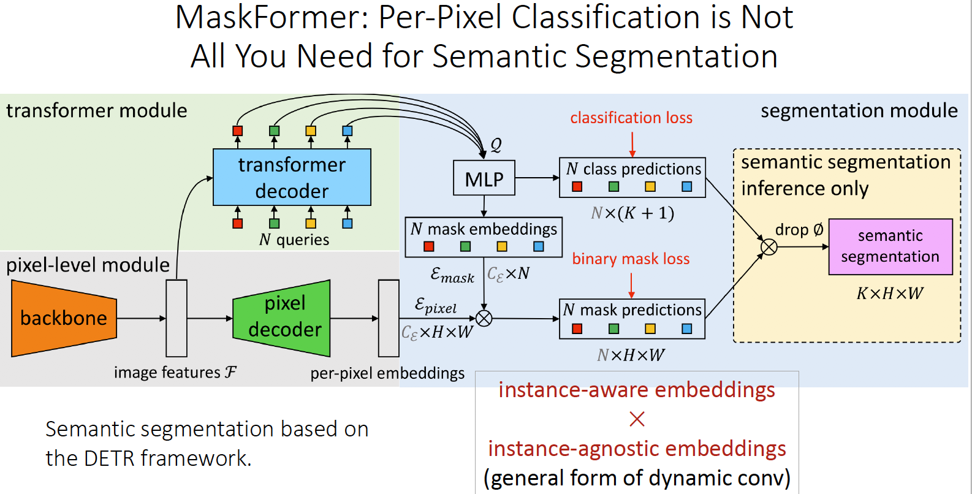
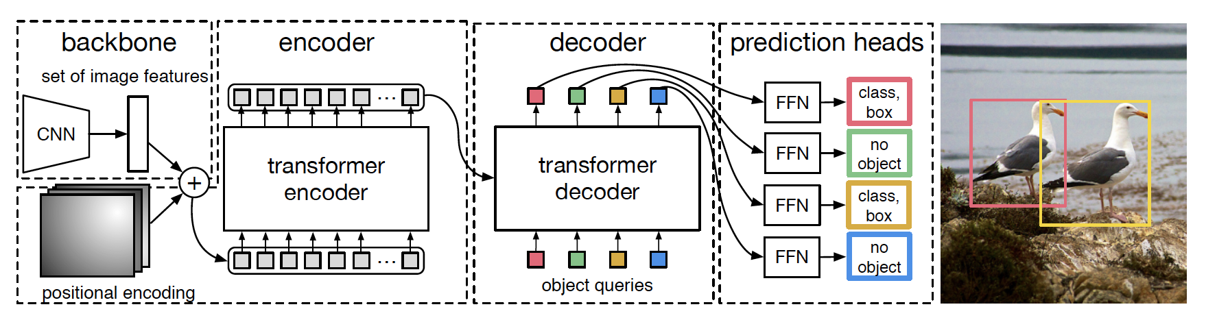
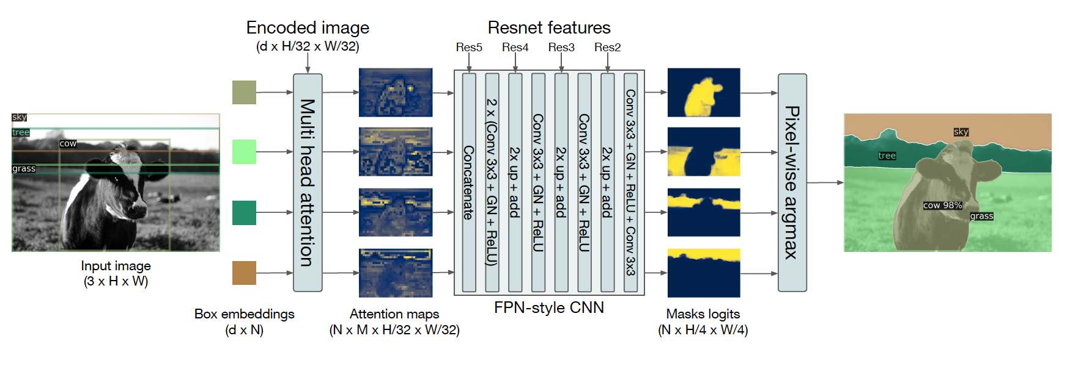
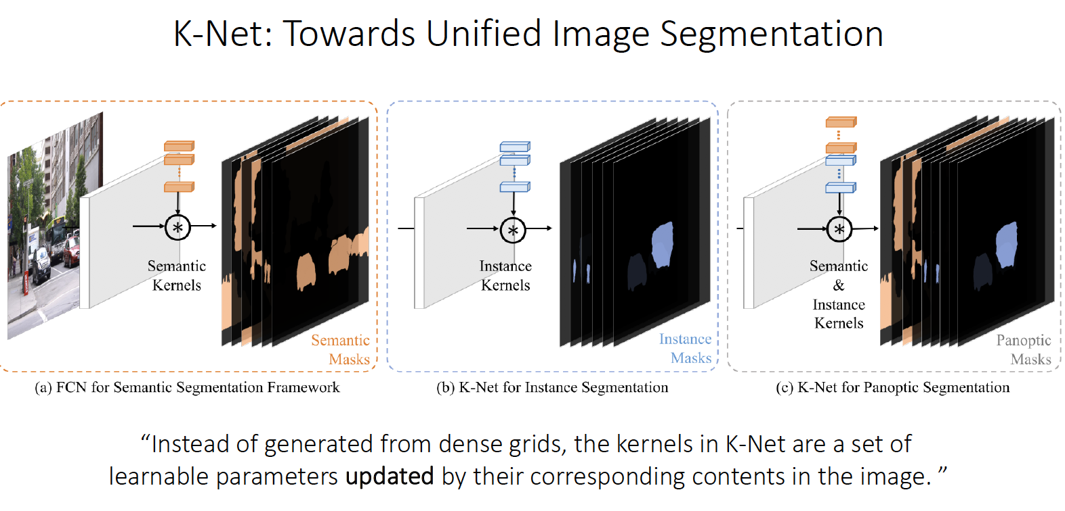
Introduction
MaskFormer/K-Net NeurIPS-2021
DETR (ECCV-2020-oral)
Notes:
感谢各位老师

Slide 5
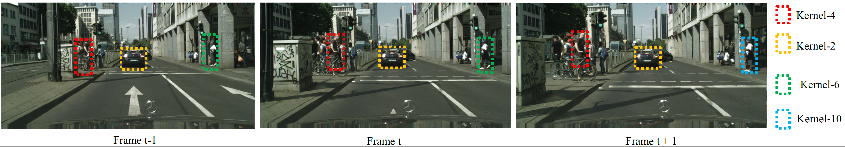
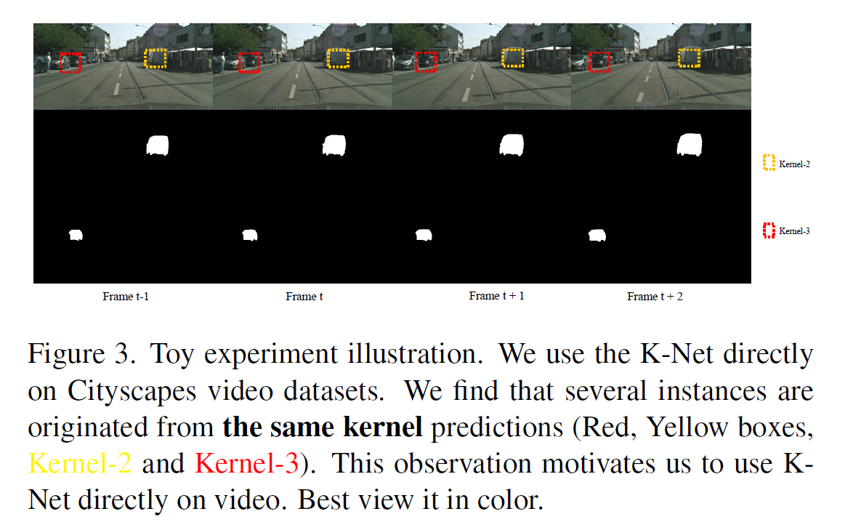
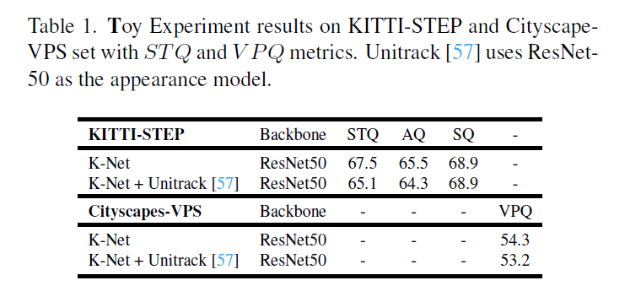
Introduction
We first perform toy experiment where we find the origin K-Net itself can achieve good tracking results and even better than specific Tracker.
Notes:
感谢各位老师

Slide 6
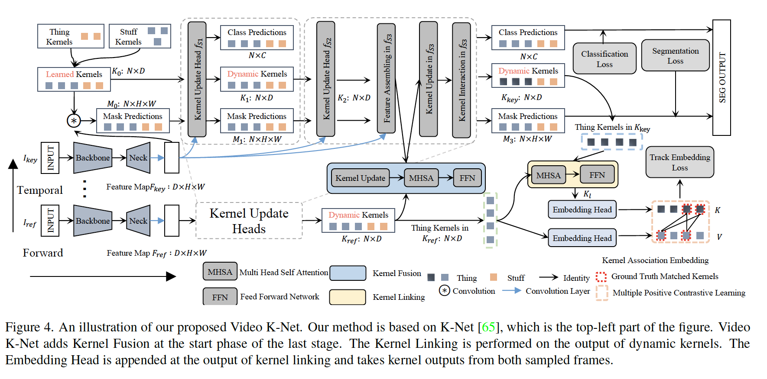
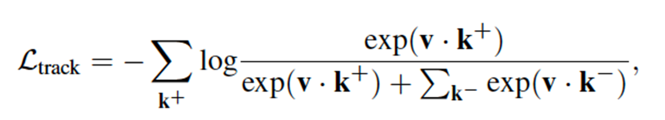
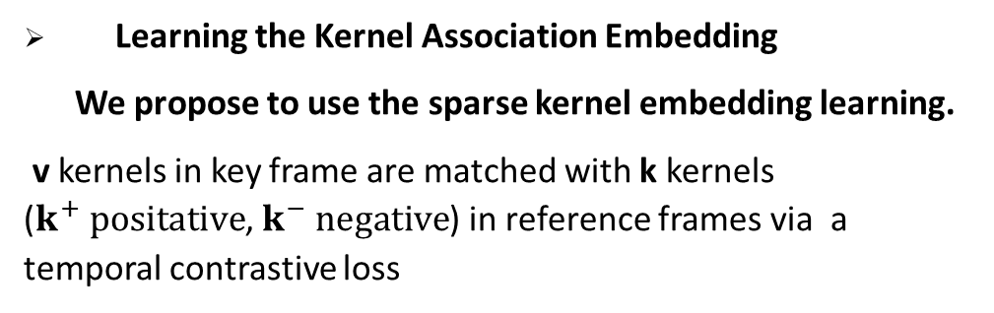
Method
Learning the Kernel Association Embedding
We propose to use the sparse kernel embedding learning.
v kernels in key frame are matched with k kernels ($k^{+} positative$, $k^{−} negative$) in reference frames via a temporal contrastive loss
Notes:
we pull the kernels with the same instance, push the kernels with different instances.

Slide 7
Method
Learning to Link Kernels.
We force to link the kernels along tracking heads for thing kernel via MSHA.
Learning to Fuse Kernels.
We propose to fuse the kernel at the last stage of K-Net via kernel update.
Generation to VSS and VIS
For VSS:
We remove the tracking branch.
For VIS:
We remove online tracking and use mean kernels to represent each object in one clip.

Slide 8
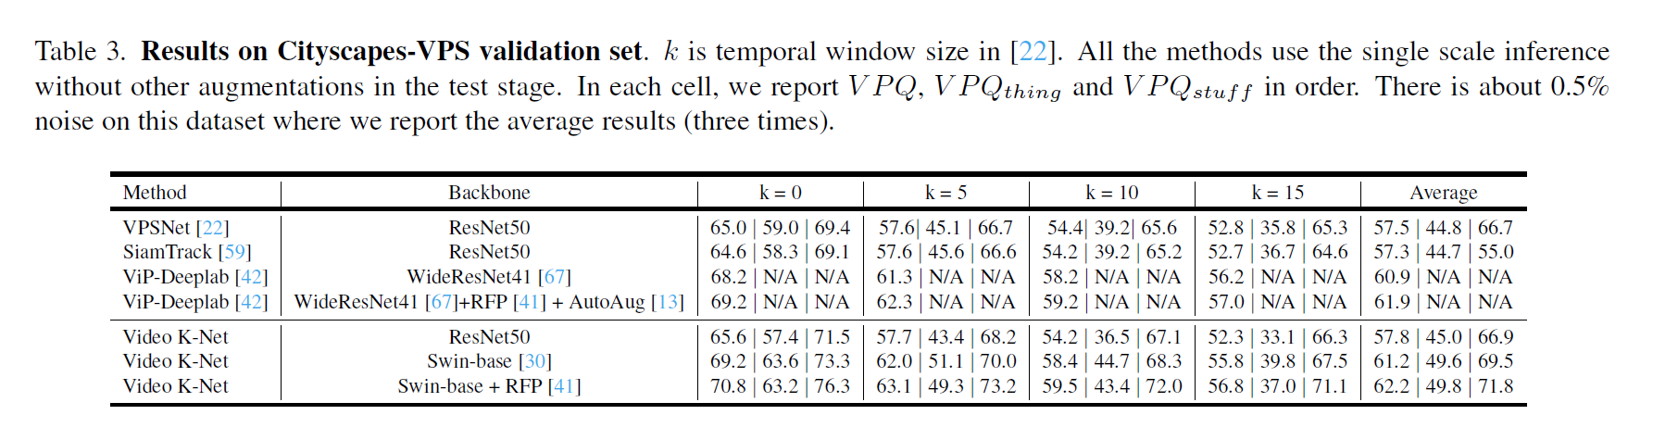
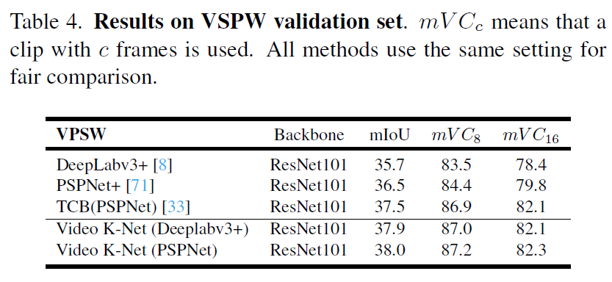
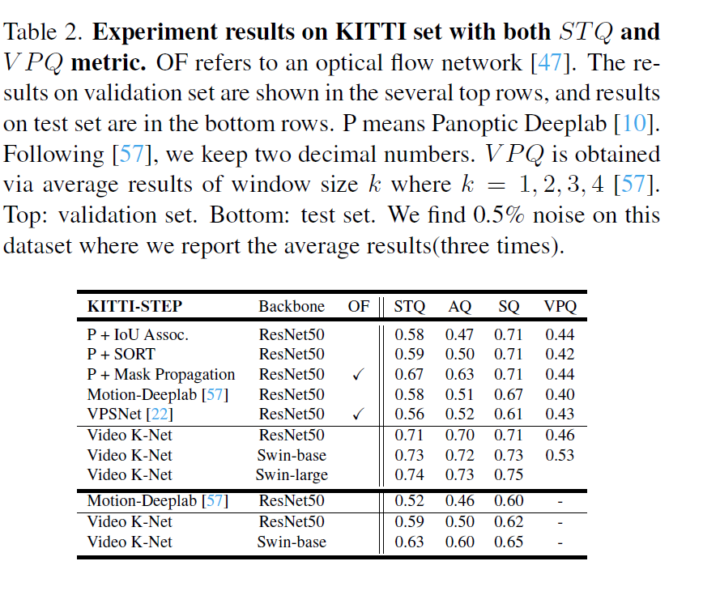
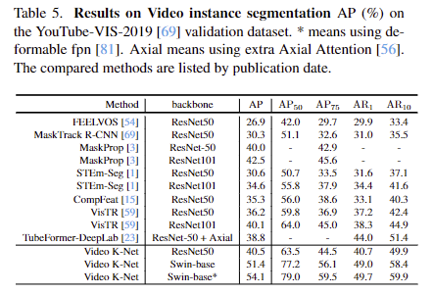
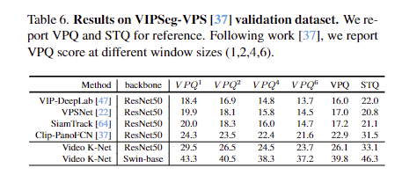
Experiment Results
New state-of-the art results on All VPS datasets. Even On Recent VIP-Seg dataset(cvpr-2022)
Considerable results on VIS and VSS datasets.

Slide 9
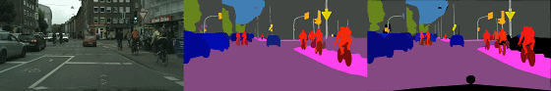
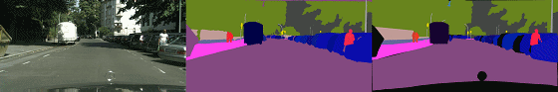

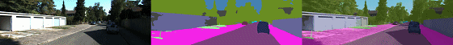
Experiment Results
Short term segmentation and tracking results on Cityscapes VPS dataset.
Long term segmentation and tracking results on STEP dataset.

Slide 10
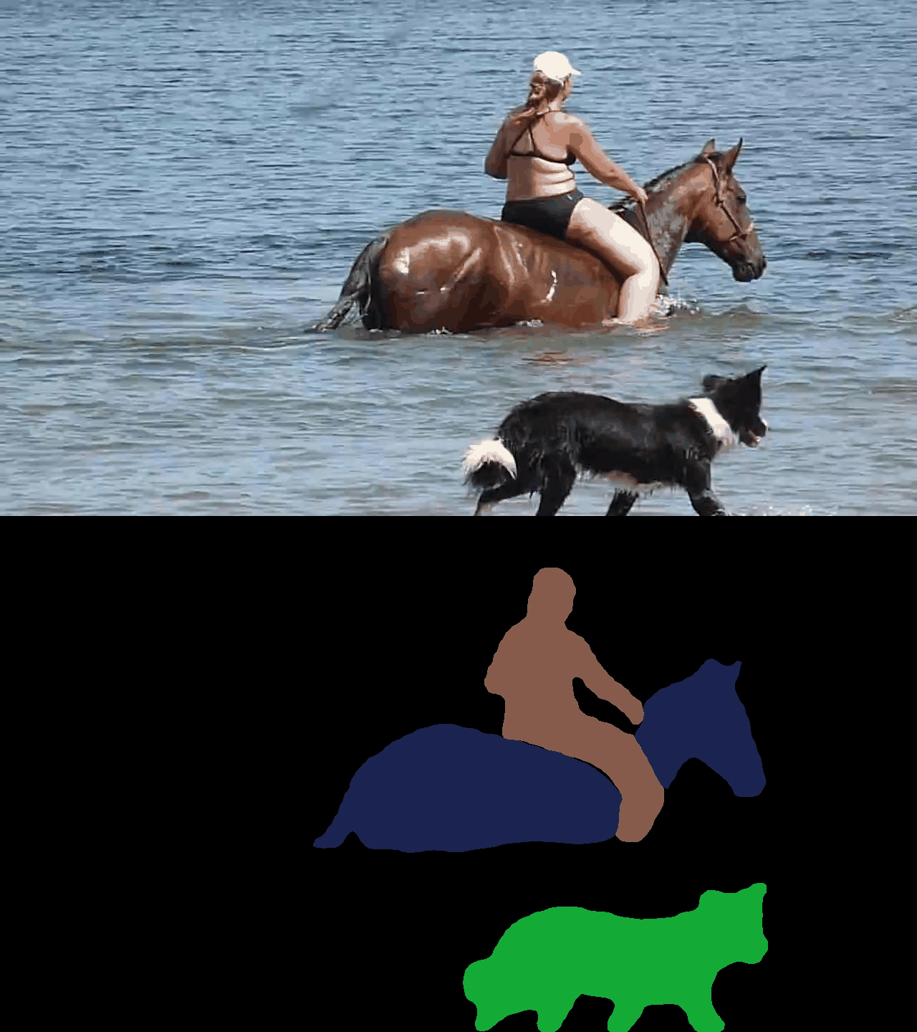
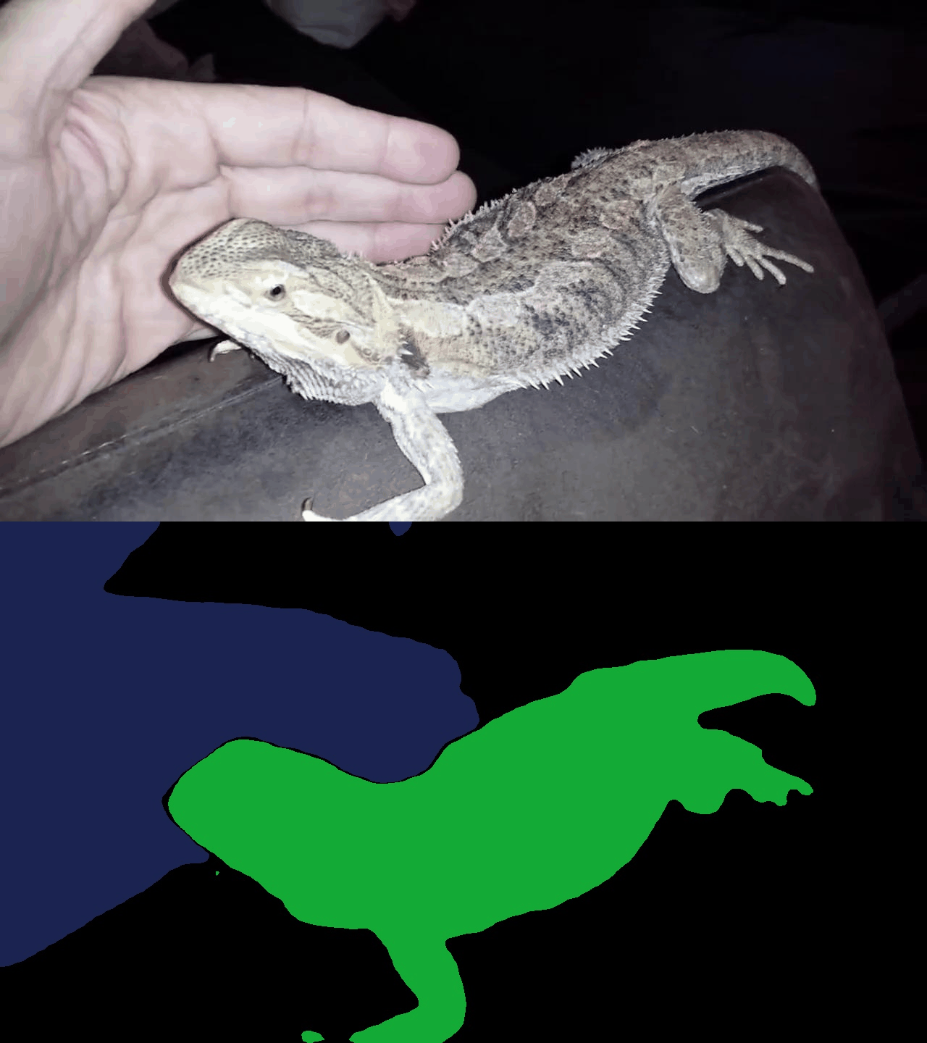
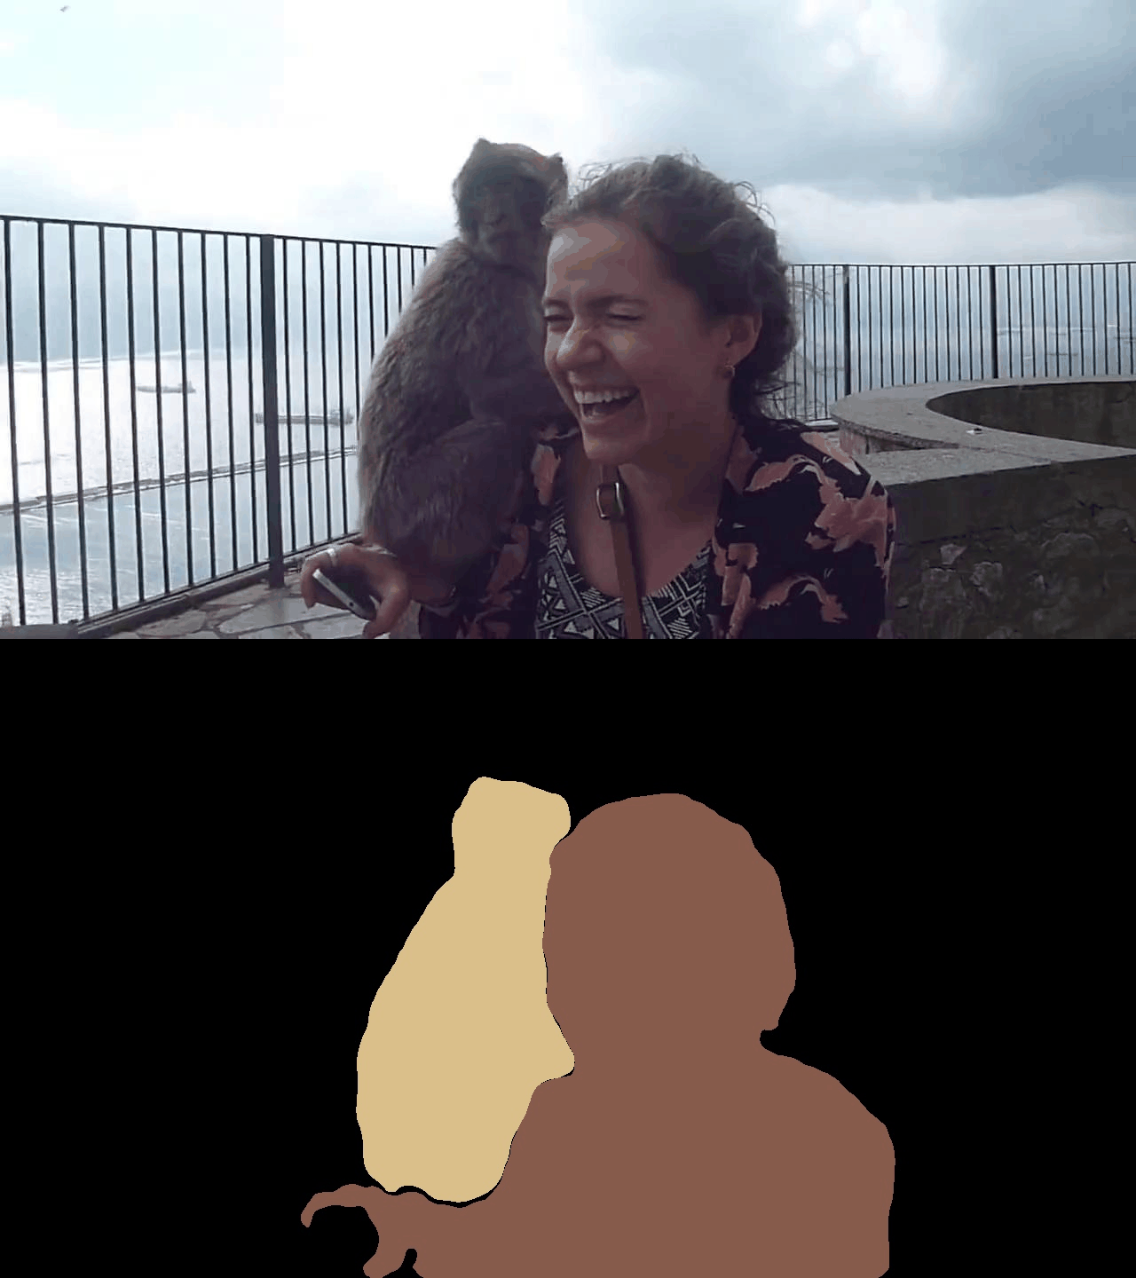
Experiment Results
Visual Results of Video K-Net on Youtube-VIS-2019 validation set.

Slide 11
Summary
Thanks For your watching!
Code and Model will be available at:
https://github.com/lxtGH/Video-K-Net

